Slide 1
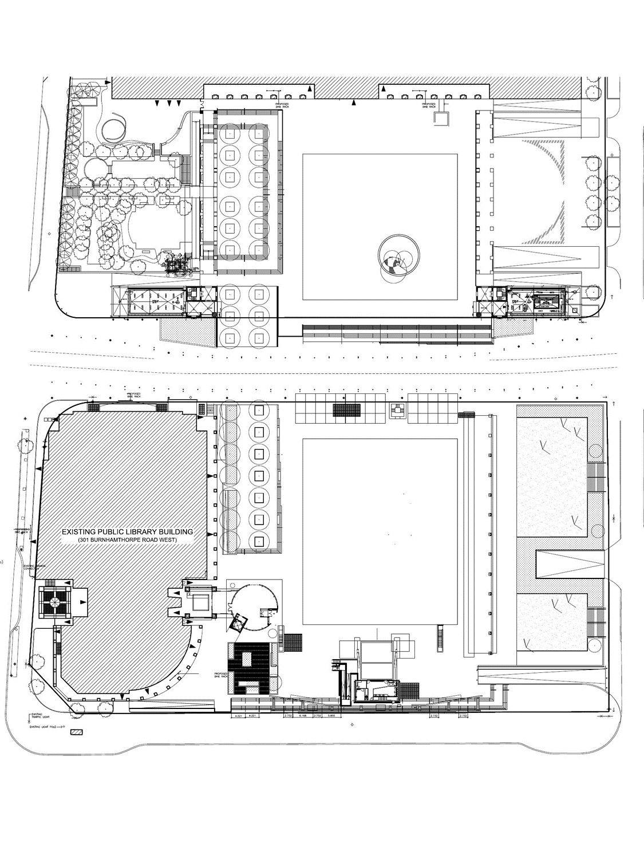







2023 MCS EVENT SITE MAP
FESTIVAL NAME GOES HERE
PRINCESS ROYAL DRIVE
LEGEND
15amp 120V
15amp 120V accessed by chord
30amp 120/208V twist lock
30amp 208V
50amp 120/208V
60amp 120/208V
Power cart (2) by request only
Pass-through by request only
Potable Water Hookup
Grey water sink
Fire Hydrant
Water Bottle Filling Station
First Aid Kit
Automated External Defibrillator
Access to parking
Accessible Washroom
Elevator to parking
Automatic bollard
Permanent bollard
B Bollard access panel
NORTH UPPER SQUARE RAMP
CIVIC CENTRE
W
C CAFÉ PATIO
W
B
CIVIC PARKING EXIT
W
LEGENDS ROW
FOUNTAIN/RINK
UPPER RAISED GARDEN
PLEASE NOTE:
THE FOUNTAIN SET UP OF PICNIC TABLES AND UMBRELLAS CAN NOT BE CHANGED
AMPHITHEATRE
(Stage & Seating
for 200)
CIVIC PARKING ENTRANCE
B
B
GARBAGE
GARBAGE
WEST STORAGE ROOM
PARKS EQUIPMENT ROOM
SOUTH UPPER SQUARE RAMP
RECYCLE
RECYCLE
B
FLAG POLES
x 6
FLAG POLES
B
WEST GATE ENTRANCE
x 2
EAST GATE ENTRANCE
CITY CENTRE DRIVE
x 6
15
DUKE OF YORK
1
LIVING ARTS DRIVE
W
W
W
W
x 6
W
W
30
2
30
CENTRAL LIBARY
LOWER RAISED GARDEN
W
3
4
5
LAWN
156’ X 189’
W
6
MARKET TRELLIS
7
W
8
LIBRARY PARKING ENTRANCE & EXIT
GLASS PAVILION
W
9
10
PERMANENT ART INSTALLATION
W
11
MAIN STAGE
12
MAINSTAGE RAMP
CLOSED
ACCESSIBLE RAMP
BURNHAMTHORPE ROAD WEST
FURNITURE
Food Vendor NO Electrical (Tented)
Metal Barricades (100 pieces) 7’ x 3.67’ ($)
#
Food Vendor NEEDS Electrical (Tented)
Regular Picnic Tables (40 units) 5’ x 3.4’ ($)
#
VENDORS – TENTS AND TRUCKS
Accessible Regular Picnic Tables (10 units) 5’ x 7’ ($)
#
Vendor NEEDS Electrical (non food) (Tented)
#
Vendor NO Electrical (non food) (Tented)
Umbrella (12 units) ($)
#
Food Truck or Display Truck without electrical
Bistro Tables + Chairs (20 units)
Generic Tent – no electrical needed

